Slide 1
INTELLIGENT TARGETING
Target more no. of people to subscribe to the term deposit
Suprajah Suresh
Sucharita Batchu
Aneesh Shinde
BIA-652D Multivariate Data Analysis
Fall 2018

Slide 2

Introduction and Aim
Banks make a profit by providing monetary services to people and one such service is term deposit. Engaging in direct marketing campaigns is one way the banks sell/provide services.
Our goal is to improve the efficiency of the next marketing campaign by:
To classify and predict whether the client will subscribe (yes/no) a term deposit
To improve the strategy for the next market campaign
To draw business insights from the data

Slide 3
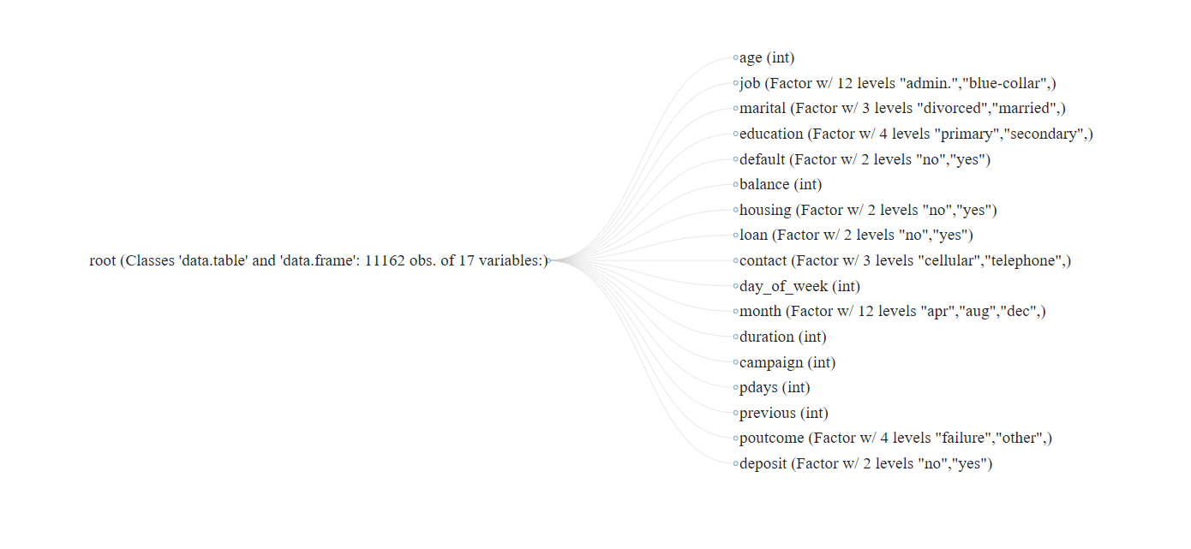
Dataset
The data is related with direct marketing campaigns (phone calls) of a Portuguese banking institution.
It is divided into bank data, client data and social & economic attributes

Slide 4

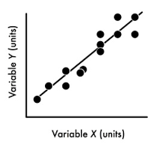

Data Modelling
Acquire Data
Clean the Data
Transform the Data
FPR
ROC
AUC
Logistic Regression
KNN
SVC
Random forest
XGBoost
Gradient Boosting
Using False Positive rate, ROC and AUC we conclude which algorithm is the best fit

Slide 5
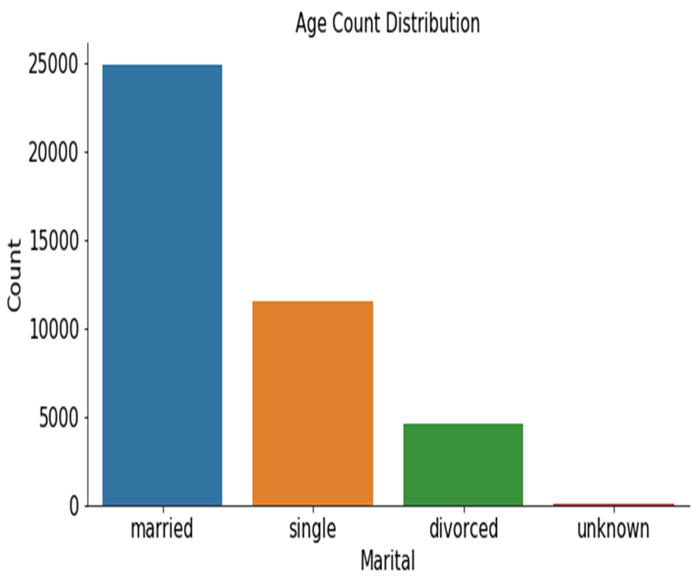
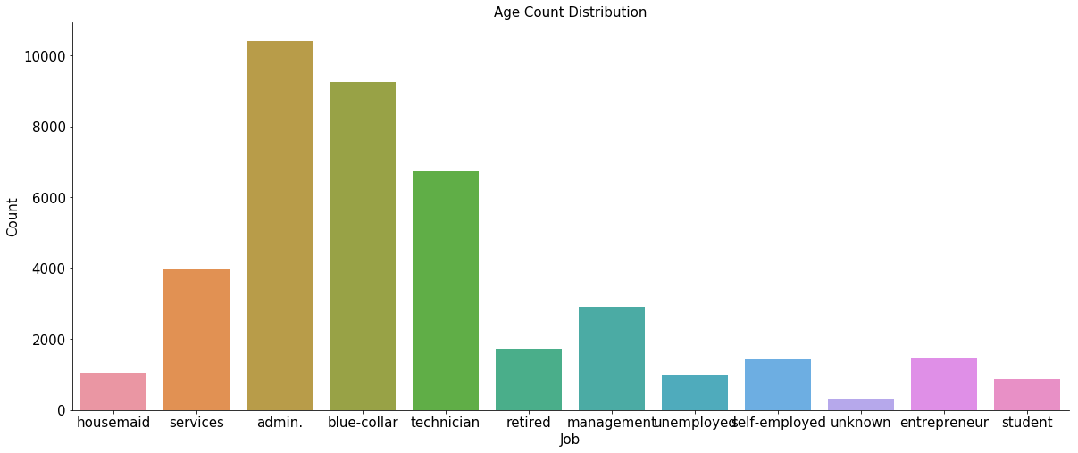
Data Visualization
The ages factor has a medium dispersion and do not seem to relate with other variables
Jobs, Marital status and Education are the best factors to analyze if a customer will subscribe.

Slide 6
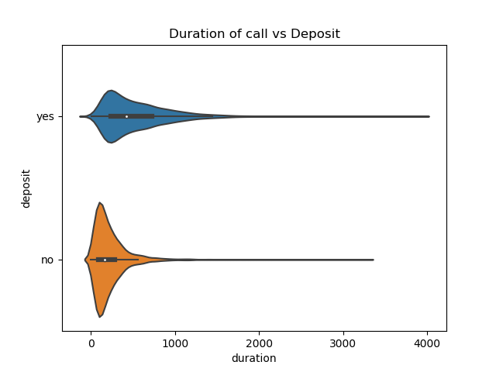
Violin Plot
A violin plot which is commonly used to compare a continuous variable with a categorical factor.
The duration of the call is recorded in seconds and the altitude of the curve determines the extent of success of the
marketing campaign.
Inference
Many customers agree to subscribe to term deposit where the call duration is long enough which indicates that there is noting wrong with the campaign but some aspects has to be improvised.

Slide 7
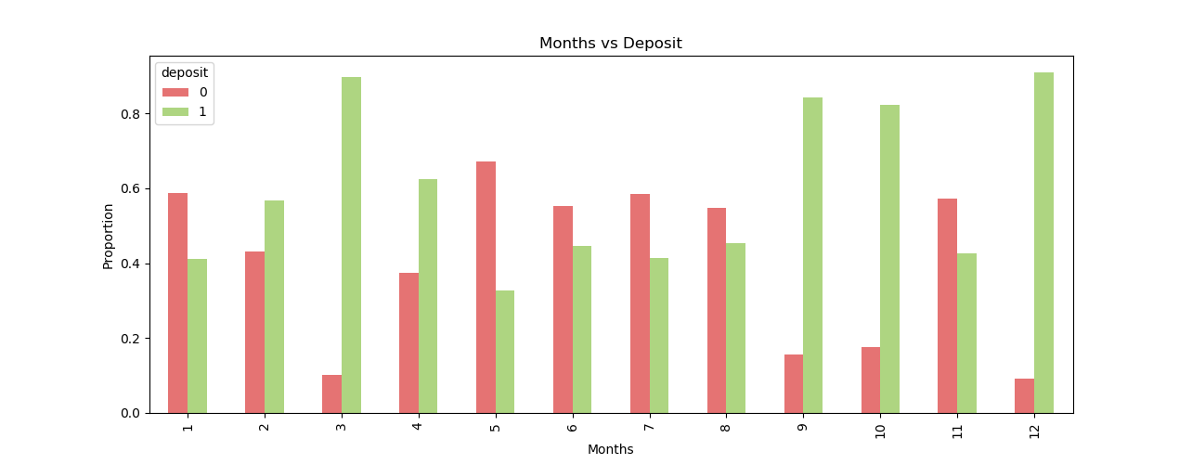
Months vs Deposit
Inferences:
Highest month of marketing activity is may. However, this was the month that many potential clients tended to reject term deposit offer
Many clients agreed to subscribe for a term deposit in the months of march and december

Slide 8
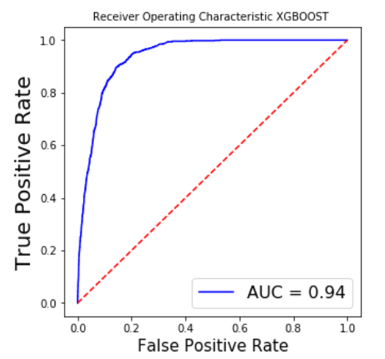
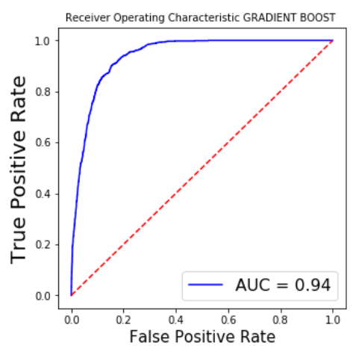
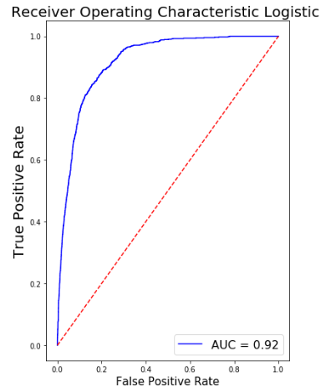
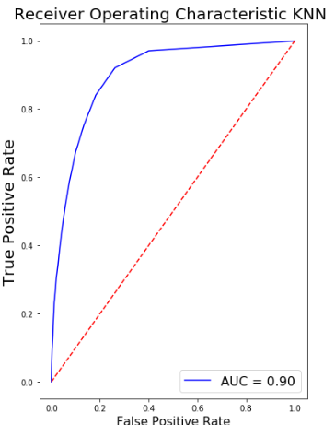
ROC Curves

Slide 9
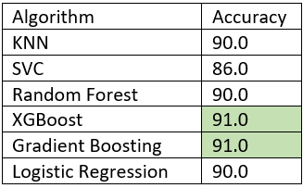
ROC Inference
Area under curve (AUC) metric is used to measure accuracy
The AUC shows that XGBoost and Gradient Boosting has the best accuracy Followed
by KNN and Logistic regression.

Slide 10
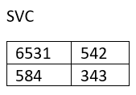
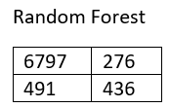
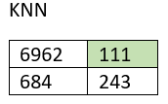
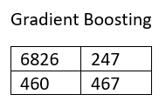
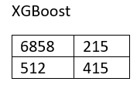
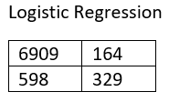
Result
Following are the confusion matrices for all the algorithms used and we pick the best
algorithm based on accuracy and least False positive rate.

Slide 11
Conclusion
Following can be to improve the next marketing campaign:
Allocate more budgets to marketing in the months of March and December
Develop a Questionnaire for the calls to keep the conversation interesting
Don’t ignore people with a loan as we have seen that loan factor doesn’t impact much

Slide 12
Thank You

